Slide 1
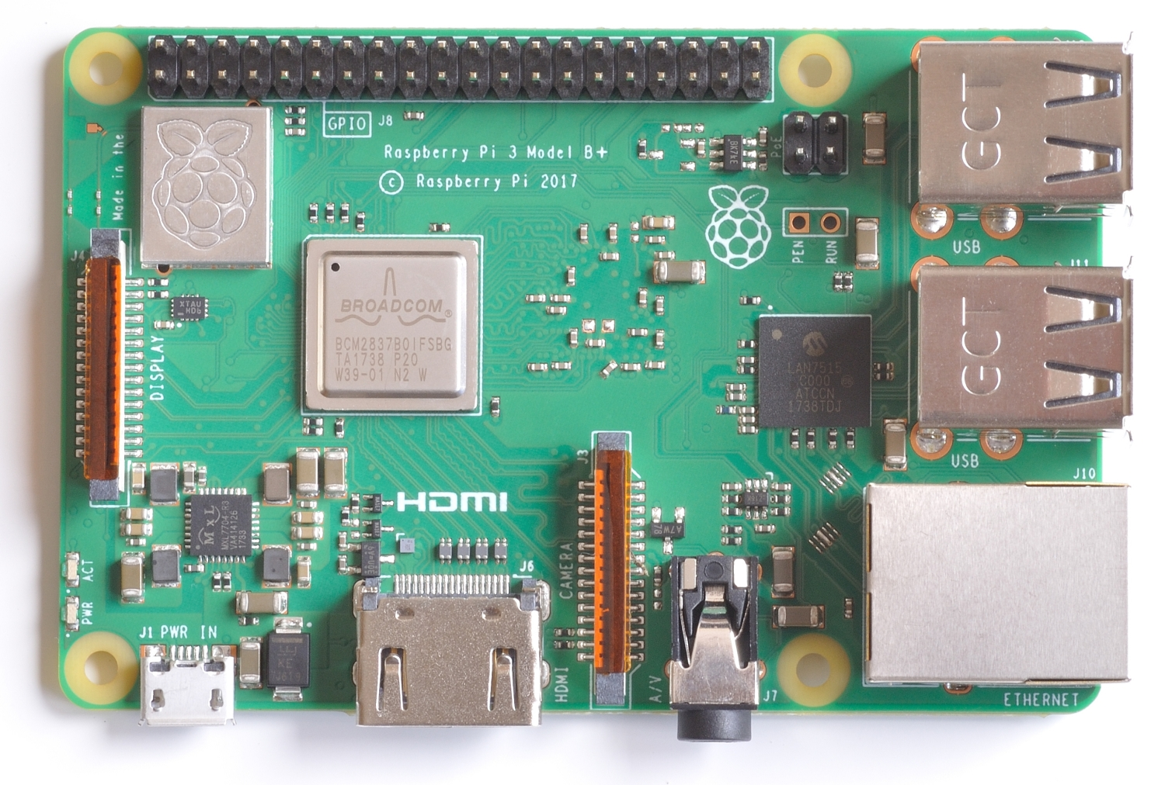
Raspberry Pi 3B+
Cortex-A53 (ARMv8) 64-bit SoC @ 1.4GHz
1GB LPDDR2 SDRAM
2.4GHz and 5GHz IEEE 802.11.b/g/n/ac wireless LAN,
Bluetooth 4.2, BLE
Gigabit Ethernet over USB 2.0 (maximum throughput 300 Mbps)
4 USB 2.0 ports
Full-size HDMI
40 GPIO pins
MicroSD card slot for operating system and data storage
3.5mm audio jack

Slide 2
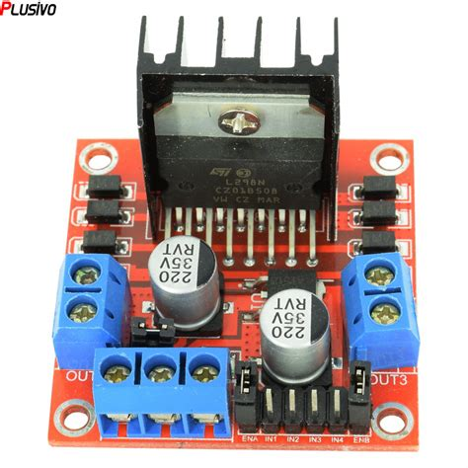
L298N Motor Driver
Dual H-bridge motor driver capable of driving two DC motors or one stepper motor
Operating voltage range: 5V to 35V
Peak current: 2A per channel
Built-in protection diodes to prevent back EMF from damaging the driver
Enable and direction control pins for each motor channel

Slide 3
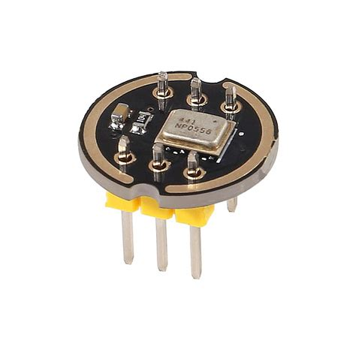
MEMS Microphone Module
MEMS (Micro-Electro-Mechanical Systems) technology for high-performance audio sensing
Small form factor for integration into compact electronic devices
Analog or digital output options for interfacing with microcontrollers or other digital systems
Low power consumption for battery-operated applications
High sensitivity and signal-to-noise ratio for clear audio capture
Wide frequency response for capturing a broad range of audio frequencies

Slide 4
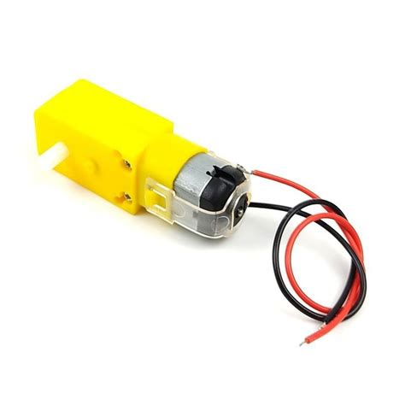
TGP01S-A130 TT Motor
Small-size DC motor
Operating voltage: typically 3V to 6V
Low current consumption for efficient battery operation
Gearbox with a high gear ratio for increased torque output
TT (Toy-Type) motor
Precise construction for smooth and reliable motor performance
Compatible with standard motor driver circuits and controllers

